Slide 1
Launching event of the Green City Accord

Slide 2
What is the Green City Accord?
The Green City Accord is a movement of European cities committed to safeguarding the environment.
In signing the Green City Accord, city leaders agree to take further action to make their cities greener, cleaner and healthier places.
The Green City Accord will support the delivery of the European Green Deal and the UN Sustainable Development Goals.

Slide 3
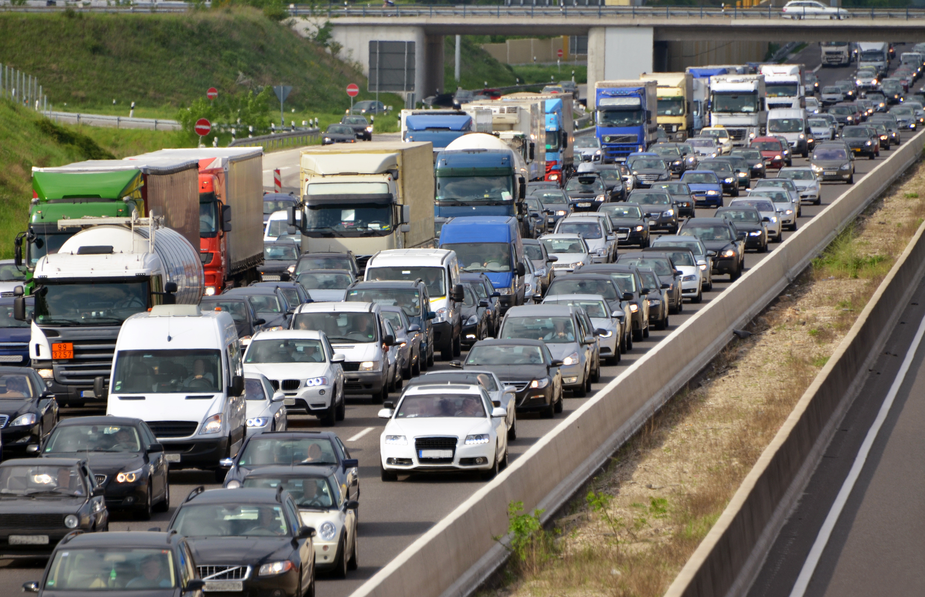
Why a Green City Accord?
Urban areas are home to some 70% of the EU’s population
Urban areas face a host of environmental challenges that pose risks to the health and wellbeing of their citizens

Slide 4
Vision
The Accord brings together mayors and leaders across Europe around a common vision of an urban future where, by 2030:
Cities will be attractive places to live:
Citizens will breathe clean air, enjoy clean water, have access to parks and green spaces, and experience less environmental noise.
The circular economy will be a reality and waste will have become a resource by greater reuse, repair and recycling.

Slide 5
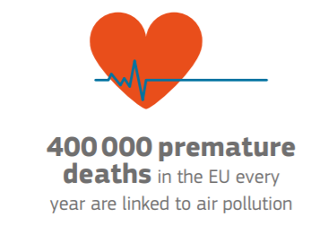
Goals – Air quality
In joining the Accord, mayors agree to taking further action to achieve the following goal by 2030:
Significant improvement in air quality in cities moving closer to respecting the World Health Organization’s Air Quality Guidelines, while ending exceedances of EU air quality standards as soon as possible.

Slide 6
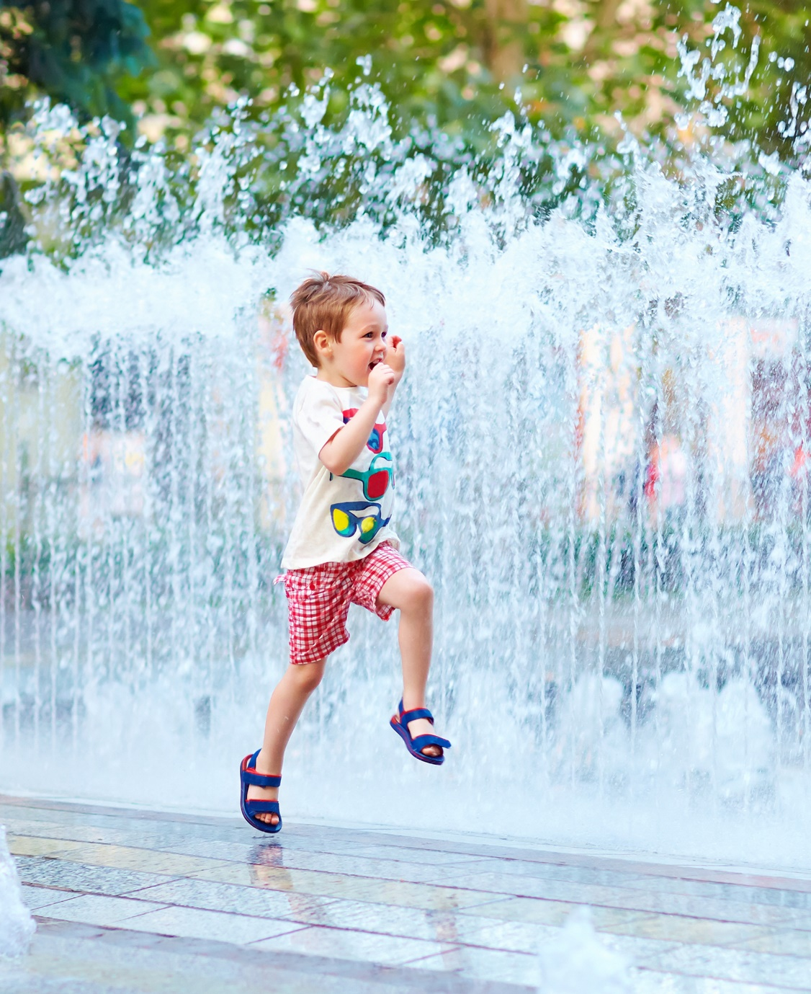
Goals – Water
In joining the Accord, mayors agree to taking further action to achieve the following goal by 2030:
Important progress in improving the quality of water bodies and the efficiency of water use.

Slide 7
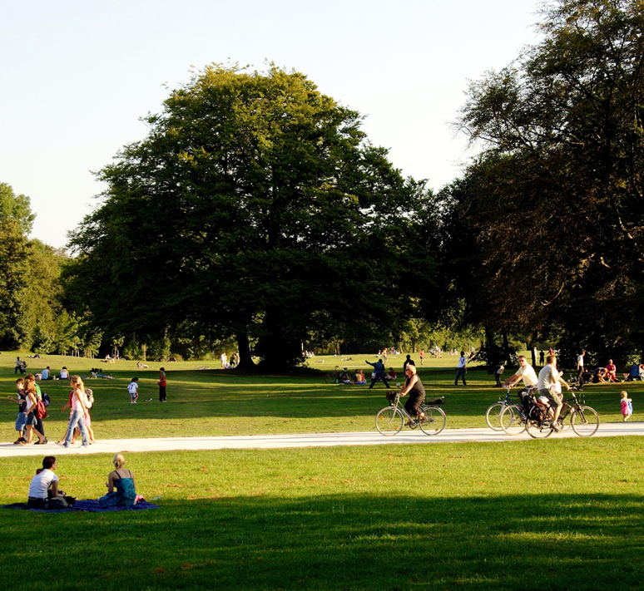
Goals – Nature and Biodiversity
In joining the Accord, mayors agree to taking further action to achieve the following goal by 2030:
Considerable progress in conserving and enhancing urban biodiversity, including through an increase in the extent and quality of green areas in cities, and by halting the loss of and restoring urban ecosystems.

Slide 8
Goals – Circular Economy
In joining the Accord, mayors agree to taking further action to achieve the following goal by 2030:
Advance towards the circular economy by securing a significant improvement in the management of household municipal waste, an important reduction in waste generation and landfilling, and a substantial increase in re-use, repair and recycling.

Slide 9
Goals – Noise
In joining the Accord, mayors agree to taking further action to achieve the following goal by 2030:
Significant reduction in noise pollution moving closer to World Health Organization’s recommended levels.

Slide 10
Why Cities should join?
The Benefits
Gain Europe-wide visibility in recognition of your city’s environmental actions and achievements.
Contribute to shaping EU environment policy and become part of a community of like-minded cities driving the transition towards a clean and healthy Europe.
Increase your transparency, accountability and credibility vis-à-vis the local community.
Gain better access to EU funding opportunities.
Participate in networking events, avail of capacity-building opportunities.
Receive tailored guidance and support via a dedicated helpdesk.
Benchmark your city achievements against progress in other cities.

Slide 11
How to join?
The Accord is open to any city located in the European Union.
The Accord step by step
SIGN: The Mayor or an equivalent representative of the council signs the Green City Accord, after an official resolution has been adopted by the local council (or equivalent decision-making body);
DEFINE: Within two years, the city establishes its ambitious targets in the five domains of the Green City Accord, and determines baseline levels reflecting the starting point in each domain;
ACT: The city plans and implements policies and programmes in an integrated manner, to achieve its targets by 2030;
MONITOR AND REPORT: The city reports back on progress every three years through an easy-to-use online tool.
Note: In this initiative, the term ‘city’ refers to an urban area, such as a community, a town, or a city with an administrative unit governed by a city council or another form of democratically elected body

Slide 12
Monitoring & reporting
After signing the Accord, the city submits within 2 years a first report containing:
Information on the baseline situation in each area;
The targets which the city has set for itself to meet by 2030;
An overview of the next steps (measures and actions) the city intends to take in order to achieve the targets.
Cities will report on progress every 3 years through an easy-to-use online tool (currently being prepared).
Reporting will include a small set of common indicators, to allow for comparability & benchmarking (the list is in preparation).

Slide 13
Support
Helpdesk
Funding
Networking

Slide 14
For more information regarding the Green City Accord, please visit www.greencityaccord.eu, or write to contact@greencityaccord.eu
The contents of this publication do not necessarily reflect the position or opinion of the European Commission.

